Slide 1
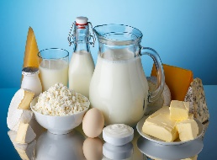
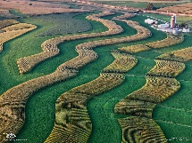
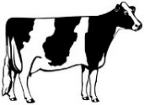
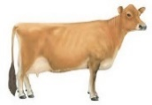
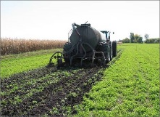
Figure 1: The Dairy Grand Challenge Project (DAPP) Illustrated – A Discover Model for Integrated Dairy Systems
Global Objectives
Develop sustainable dairy food production systems that improve human health and well-being.
Understand the GEM(S) iterative relationships among soils, forages, cows and dairy products.
Improve the productivity, efficiency, and sustainability of dairy systems on a landscape scale.
Identify system inefficiencies (leaks) and develop multi-disciplinary research based strategies to address them.
Determine how public health related to dairy is influenced by integrated dairy production systems.
Dairy product research
Nutritional value of milk for human health
Novel milk products
Value of milk products on-farm
Externalities
climate change, land price, competition, regulation , water limitations, energy costs
Leaks
forage loss, feed quality, metabolic loss, forage & cow production, efficiency
Leaks
nutritional value of milk, human health, novel products, consumer demand
Better cows
Better milk
Forage research
Forage systems that protect and enhance ecosystems
Forage breeding, production and management to optimize cow performance and efficiency
Economic values for ecosystem services provided by forages
Better forages
Better cows
Dairy cow research
Milk production and quality
Feed and production efficiency
Nutritional value of milk
Animal health and well-being
Manure management/recycling
Sustainable Dairy Production Systems
Externalities
climate change, competition, regulation, nutrient availability, public demand, water limitations
Better soils
Better forages
Better cows
Better soils
Externalities
climate change, competition, regulation, consumer demand
Leaks
soil erosion, organic C and nutrients losses; air & water quality; GHG emissions
Leaks
soil health, nutrient loss, water quality, pathogens, odors, GHG emissions
Soil health research
Soil health and resilience, soil carbon
Nutrient cycling, N and P retention and utility
Soil erosion and water quality

Slide 2
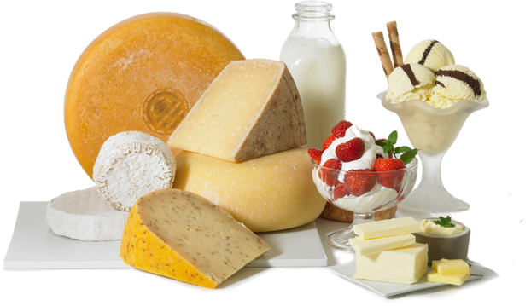
Figure 2: The Dairy Grand Challenge Project (DAPP) Illustrated – Participants and Information Flow
Global Objectives
Develop sustainable dairy food production systems that improve human health and well-being.
Understand the GEM(S) iterative relationships among soils, forages, cows and dairy products.
Improve the productivity, efficiency, and sustainability of dairy systems on a landscape scale.
Identify system inefficiencies (leaks) and develop multi-disciplinary research based strategies to address them.
Determine how public health related to dairy is influenced by integrated dairy production systems.
Industry Partners
US Dairy – DMI
Funding Partners
USDA-ARS
USDA-NIFA
USDA-ARS Nutrition
Beltsville, MD
Fargo, ND
Wyndmoor, PA
USDA-ARS Dairy Science
Madison, WI
Beltsville, MD
Clay Center, NE
USDA-ARS National Programs
NP107 Human Nutrition
NP306 Product Quality …
NP101 Food Animal Prod …
NP211 Water Availability …
NP212 Soil and Air
NP215 Grass, Forage and …
NP216 Sustainable Ag Systems
USDA-ARS DAWG
Madison, WI
University Park, PA
Kimberly, ID
St. Paul, MN
Ames, IA
Bushland, TX
Fort Collins, CO
Sustainable Dairy for Human Health and Well-being
University Partners
University of Wisconsin
University of CA - Davis
USDA-ARS LTAR
Ames, IA
University Park, PA
St Paul, MN
USDA-ARS NUOnet
Fort Collins, CO
USDA-ARS Data Management Team
Legend:
DAWG: Dairy Agro-ecosystem Working Group
LTAR: Long Term Agro-ecosystem Research Network
NUOnet: Nutrient Use and Outcome Network
Information flow
Data and information flow/iteration

Slide 3
Figure 1: Food Animal System Research Illustrated – A Discover Model for Integrated Production Systems
Global Objectives
Develop sustainable food animal production systems that improve human health and well-being.
Understand the GEM(S) iterative relationships among system factors – Genetics x Environment x Management x Socio-economic.
Improve the productivity, efficiency, and sustainability of food animal systems on a landscape scale.
Identify system inefficiencies (leaks) and develop multi-disciplinary research based strategies to address them.
Food Animal Product Research
System Externalities
Iterative
Improvement
Researchable Leaks
Researchable Leaks
Iterative
Improvement
Animal Production Research
Crop/Forage Production Research
Food Animal Systems Research
System Externalities
Iterative
Improvement
Iterative
Improvement
System Externalities
Researchable Leaks
Researchable Leaks
Soil Health & Ecology Research

